Slide 1
MY PORTFOLIO
Leah hou

Slide 2
Design Process
Step 1: check in as many website as possible
Step 2: screenshots all elements I like about and draw ideas on how I would like to have my website is like
Step 3: Moodboarding in Indesign (basically drag and print all images)
Step 4: website architects planning
Step 5: Wireframe
Step 6: hi-fi version

Slide 3
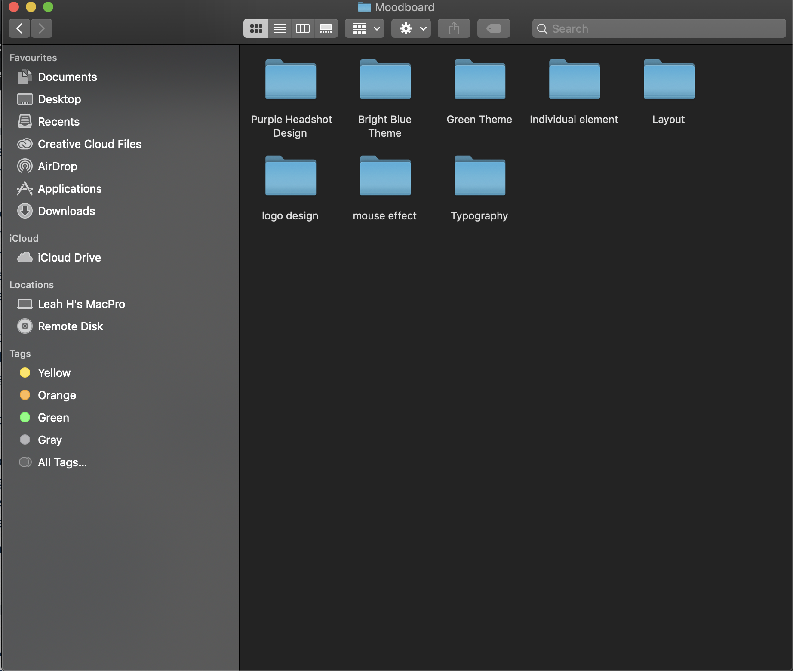
Getting started

Slide 4
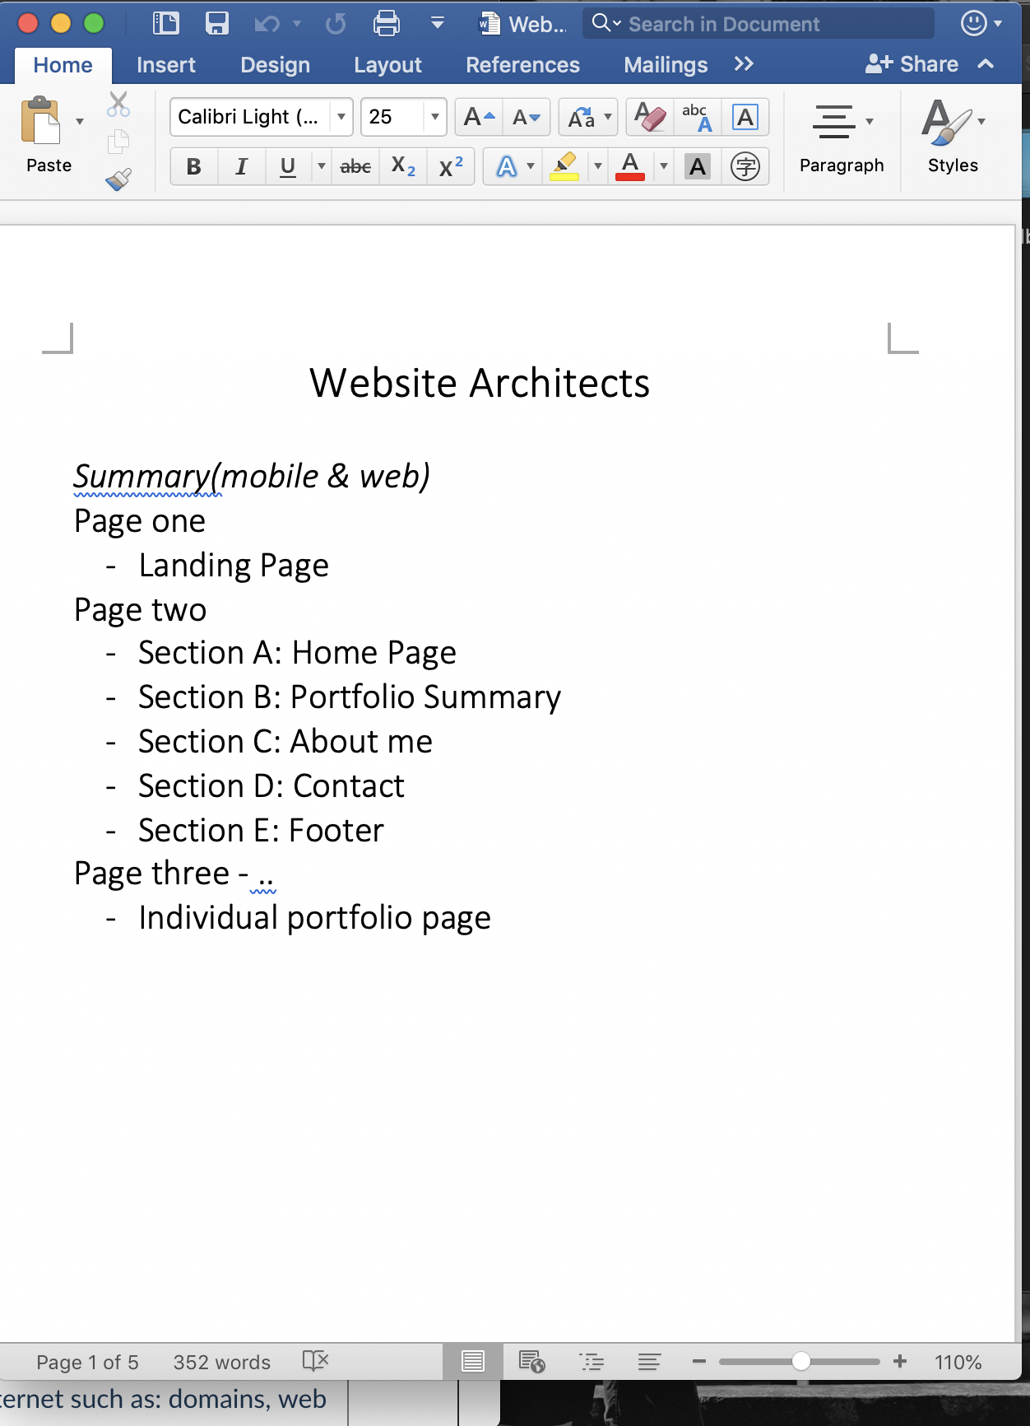
Website content planning

Slide 5
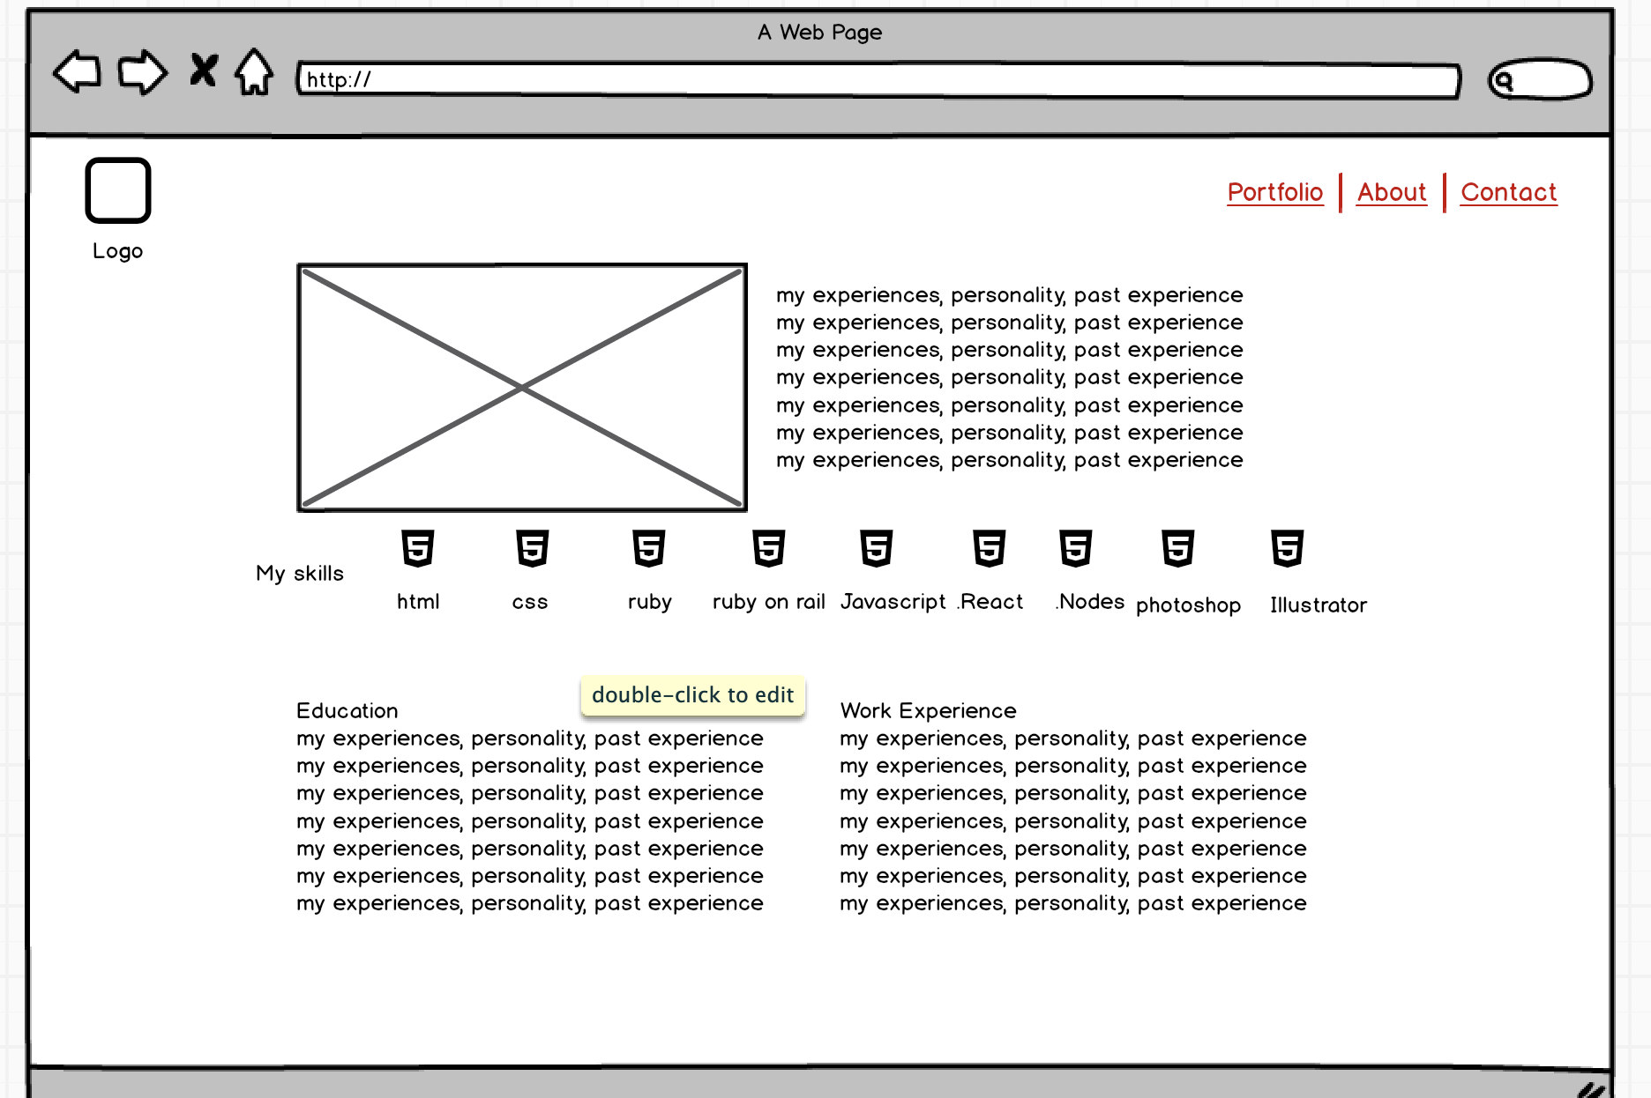
Wireframe

Slide 6
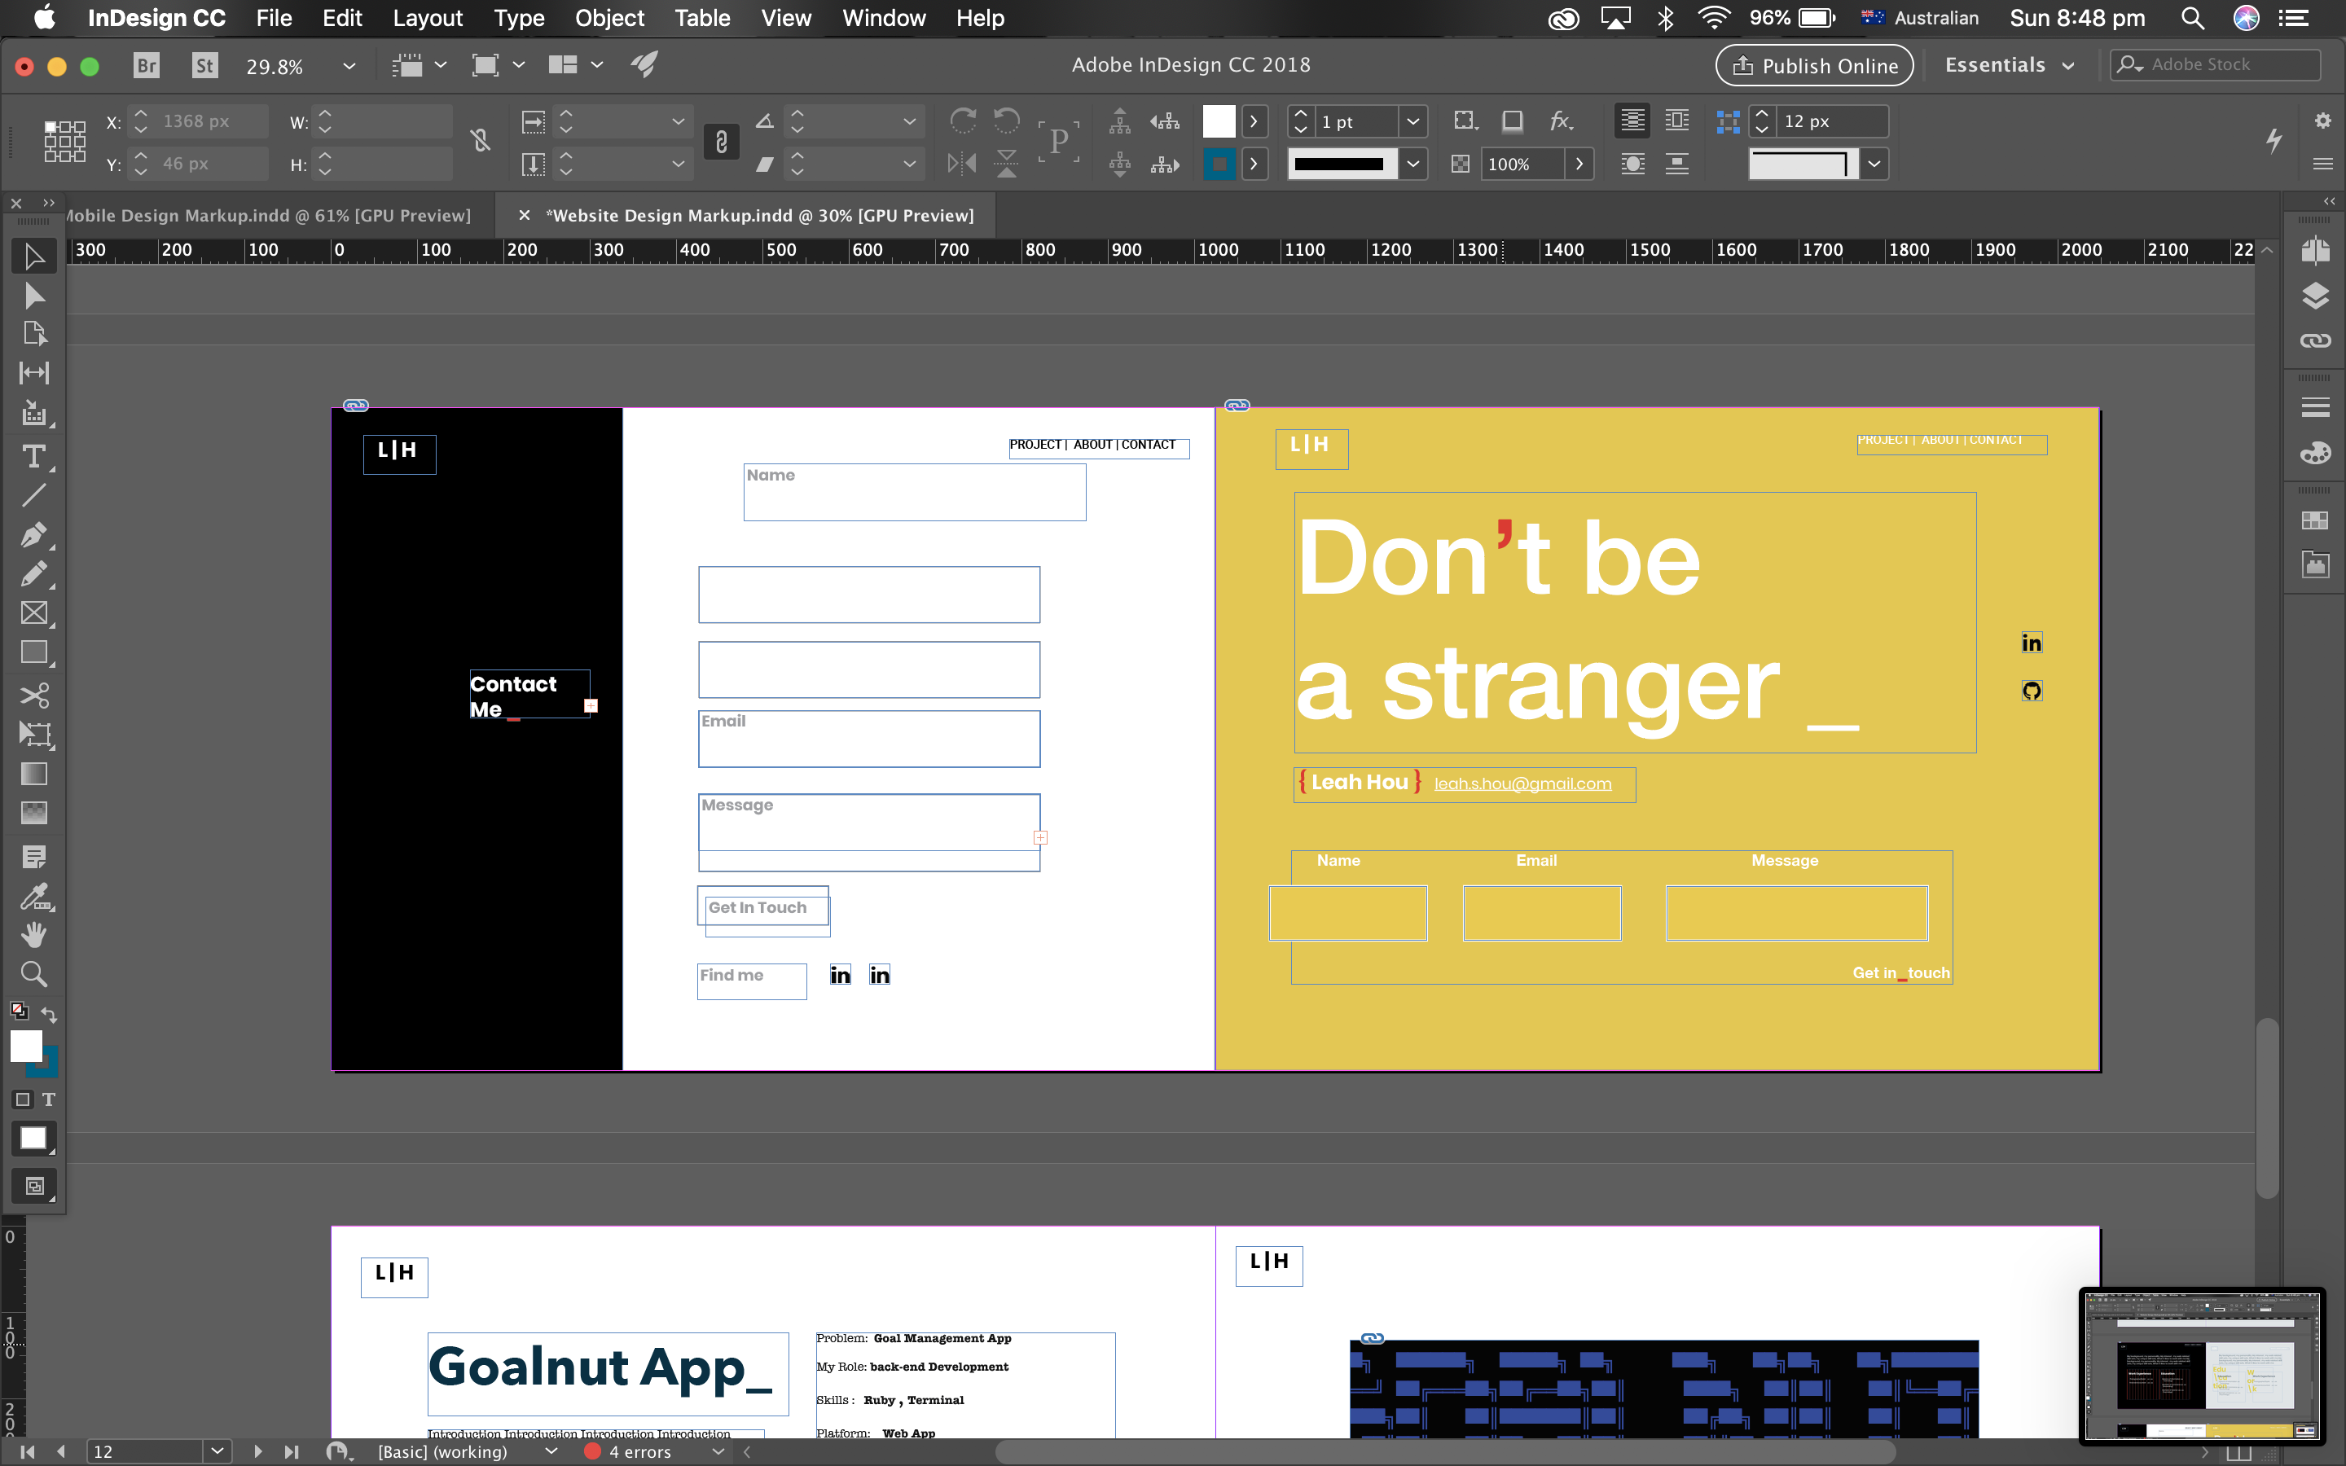
Draft design →final design

Slide 7
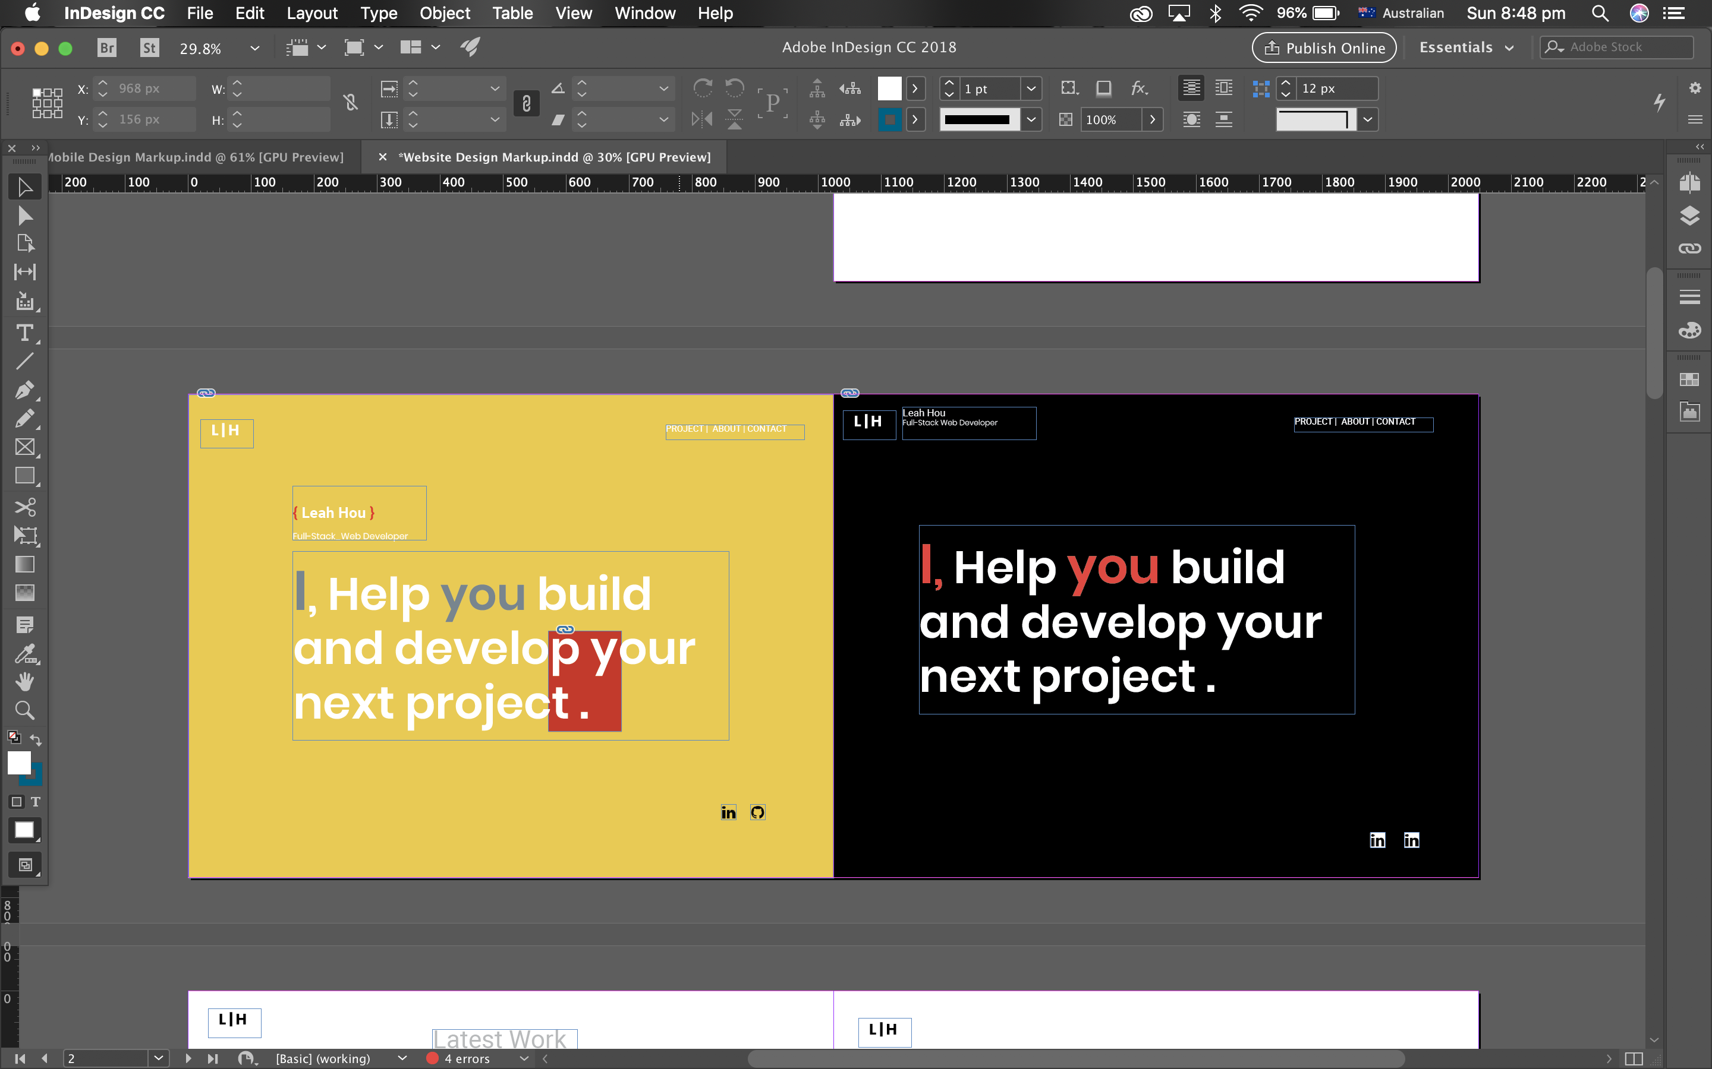
Draft → final design

Slide 8
Site Tour!!!

Slide 9
Review of my development process
The Challenge
Design part
What I visioned does not match with my hi-fi version.
Having doubt about myself
Event: See other people progress so much when I am still drawing my hi-fi design on Monday. Especially in the middle of when I am making the hi-fi version, I feel like what I see is not what I vision it looks like, whereas I saw lots of people far ahead of me and I was in the dilemma whether I should go ahead and getting start in case I cannot finish or spend longer to finalise my design
Balance time to learn and practice skills versus just get things done!
Time management
It is hard to measure how long certain part of website will take, and I end up not be able to follow the original time frame I set for myself.
What I have learnt
Stick with what I think is the best
Practice, practice and practice
Try to do my best !
Fun part
I am super happy that I did it
Add animations!

